Slide 1




Elon’s MUsk Biography
Alejandro Giraldo Hererra

Slide 2
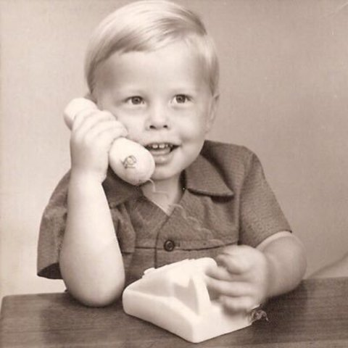
Elon Musk was born on June 28th, 1971 in Pretoria, Sudafrica.

Slide 3
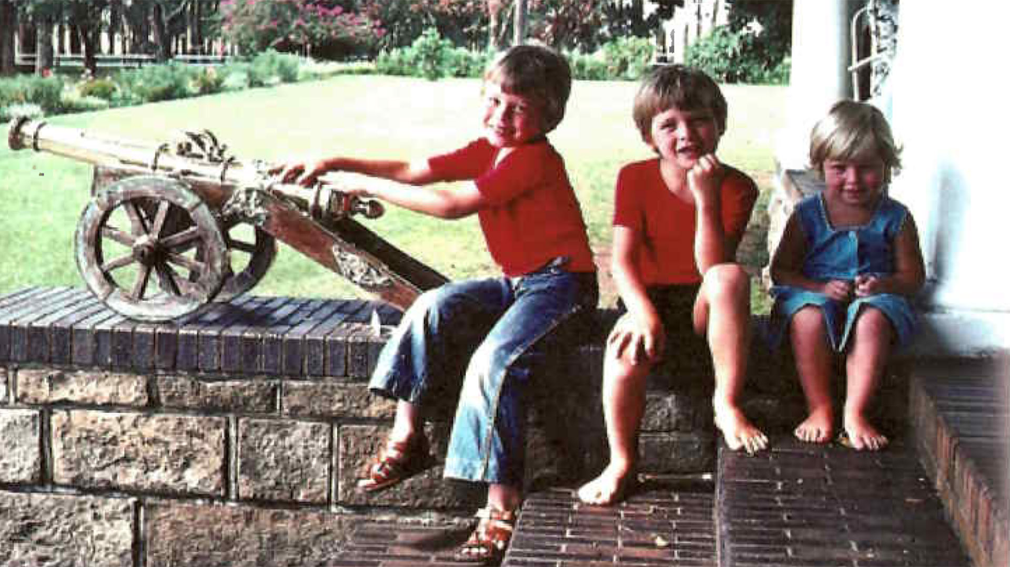
When he was 10 years old, he become a programmer

Slide 4
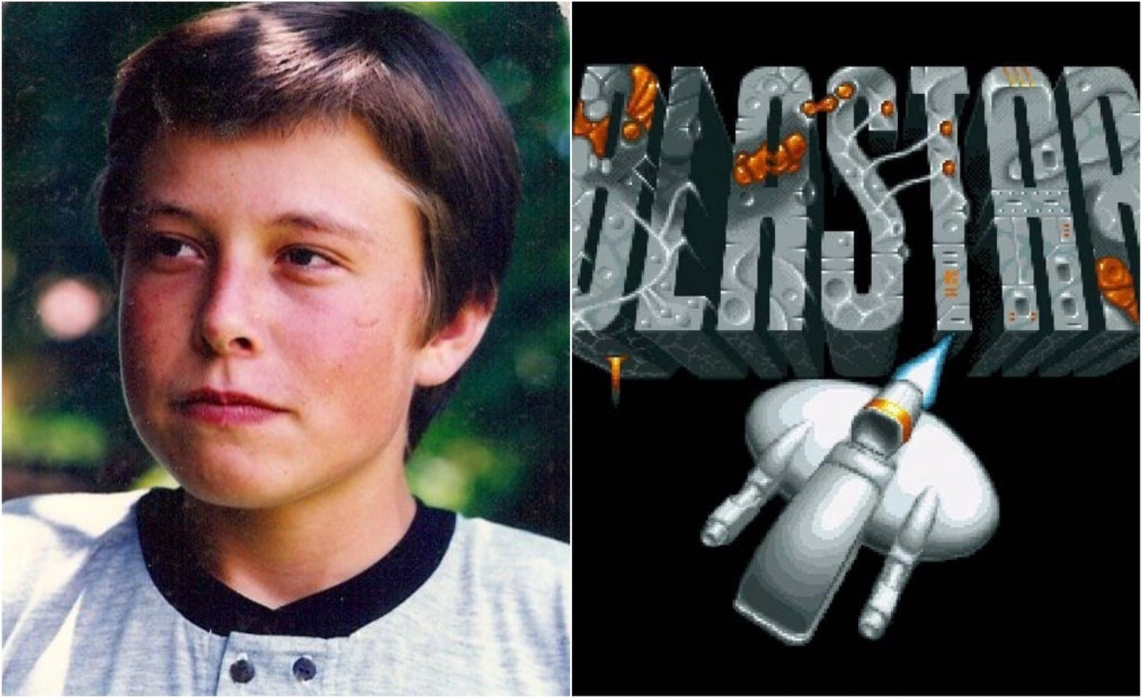
At 12 years old, he sold his videogame Blastar for 500 dolars

Slide 5
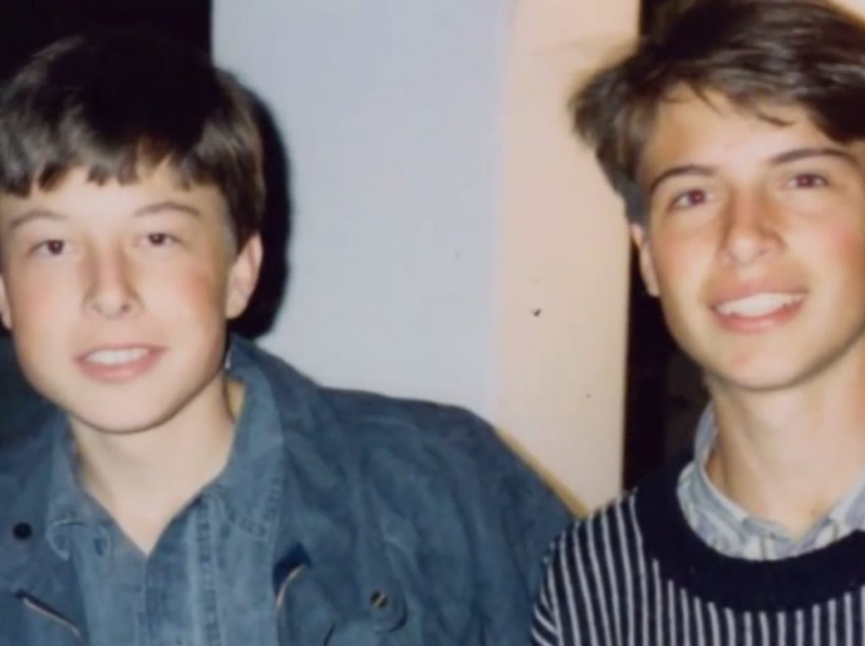
At 17 years old, he decided to leave home for go to live in Canada.

Slide 6
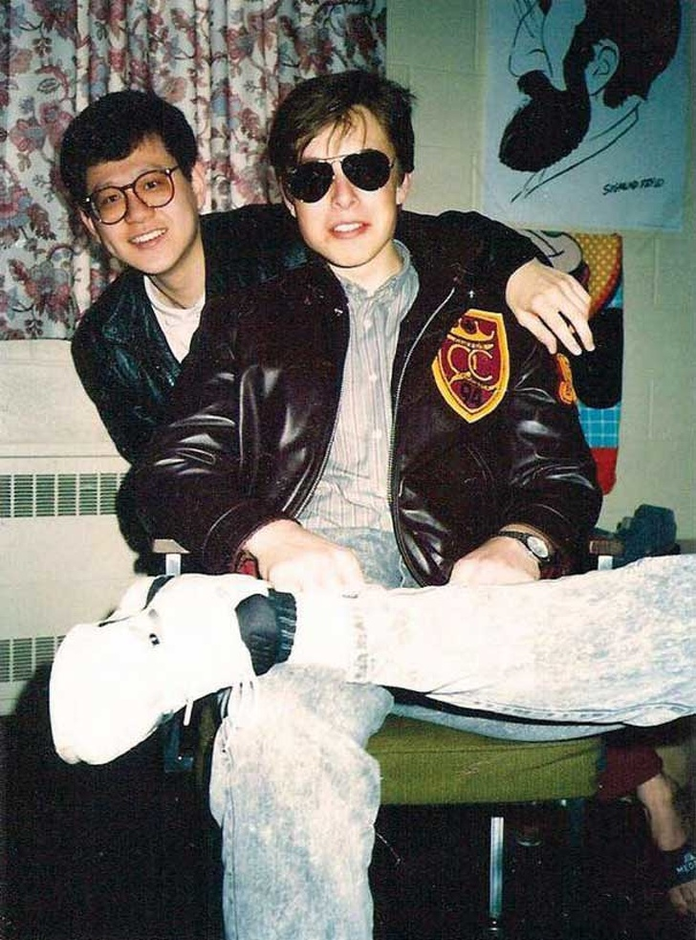
When he was 18 years old, he returned home whit is mother for go to live in Kingston, Ontario.

Slide 7
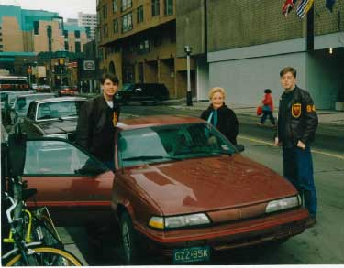
He joined at Pennsylvnia University in 1992.

Slide 8
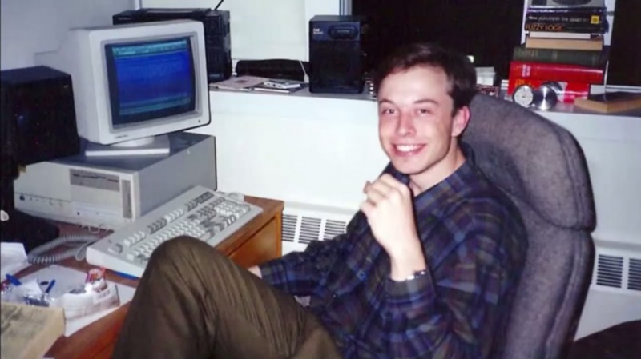
After finishing, he joined at Stanford University in1995.

Slide 9
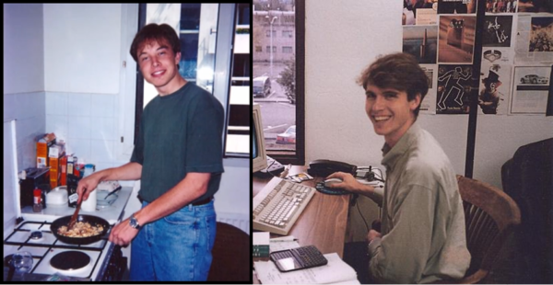
A few days later, he decided to leave the university to create his own company Zip2 with his brother Kimbal ans his friend Greg Kouri.

Slide 10
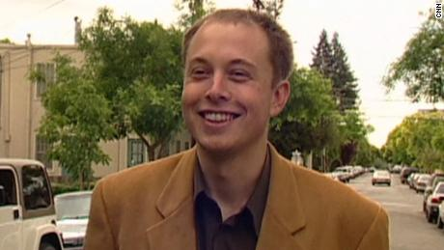
In 1999, they sold Zip2 for $307.000.000, of which $22.000.000 was from Elon

Slide 11
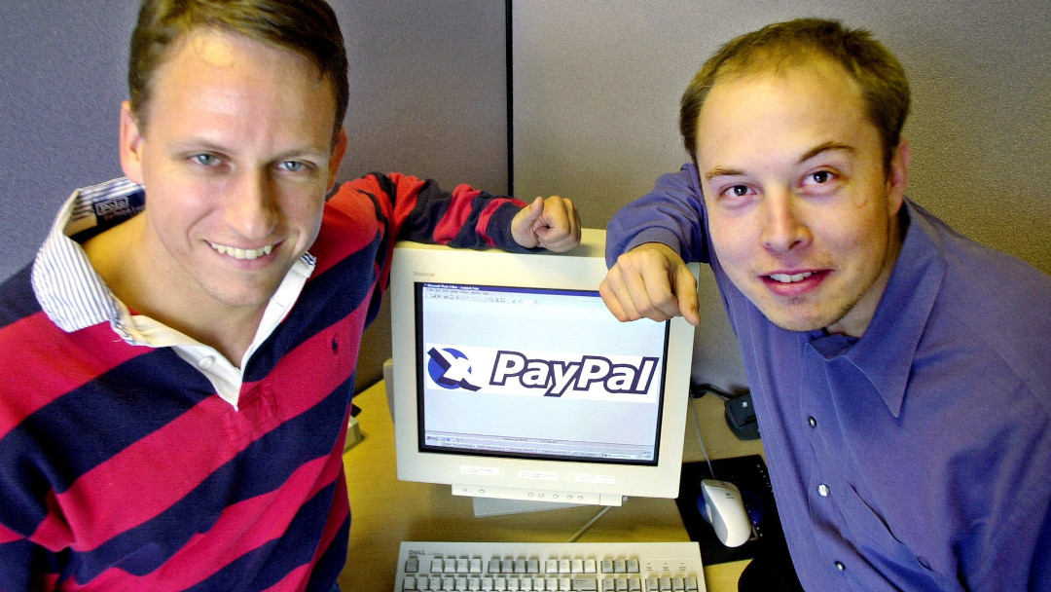
In the same year, he invested $12.000.000 in X.com a financial company, called PayPal in 2001. He become in his CEO

Slide 12
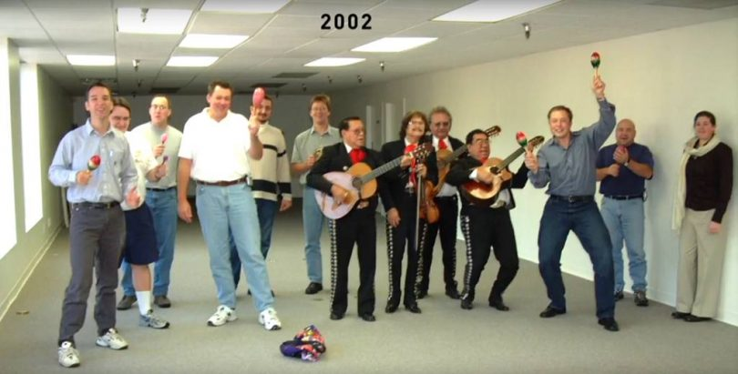
In May 2002 he founded SpaceX, a company with the objetive to the spacial exploration.

Slide 13
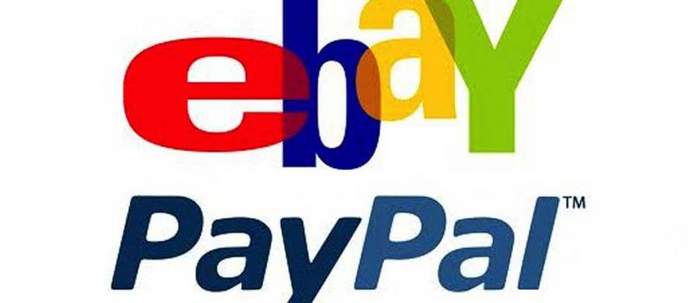
In July 2002 they sold PayPal to eBay for $1.500.000.000

Slide 14
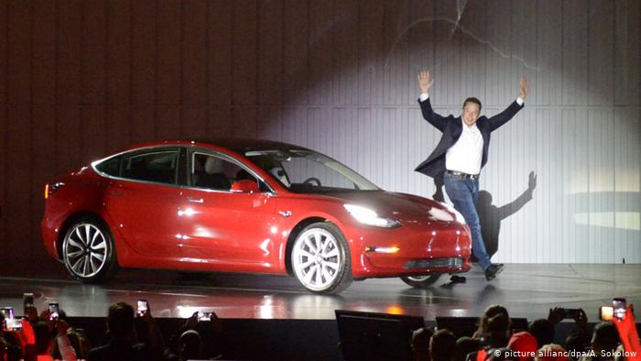
In 2003 he founded Tesla Inc a automobile manufacturer company.

Slide 15
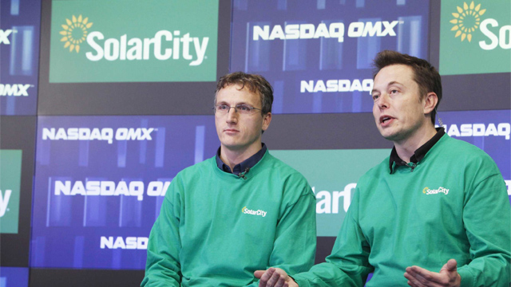
In 2006 he founded Solar City a solar energy provider.

Slide 16
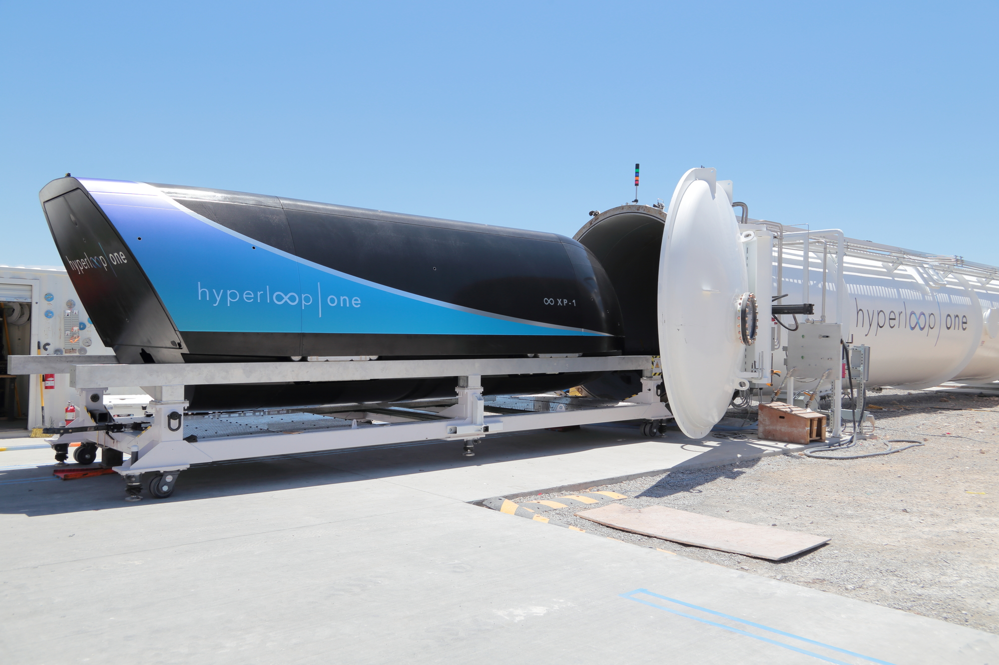
In 2014 he founded Hyperloop One, a cargo or passenger transport with a speed like the speed of airplanes but is more economical

Slide 17
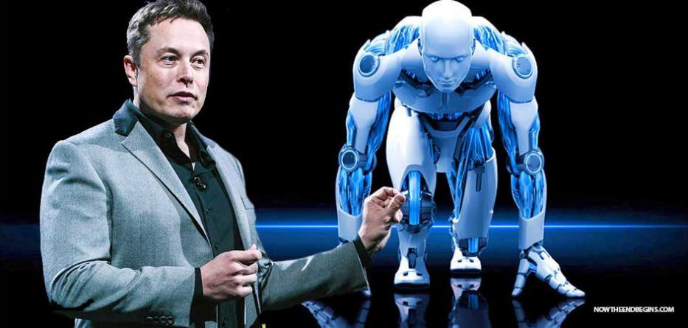
In 2015 he founded Open Ai, a artificial intelligence company

Slide 18
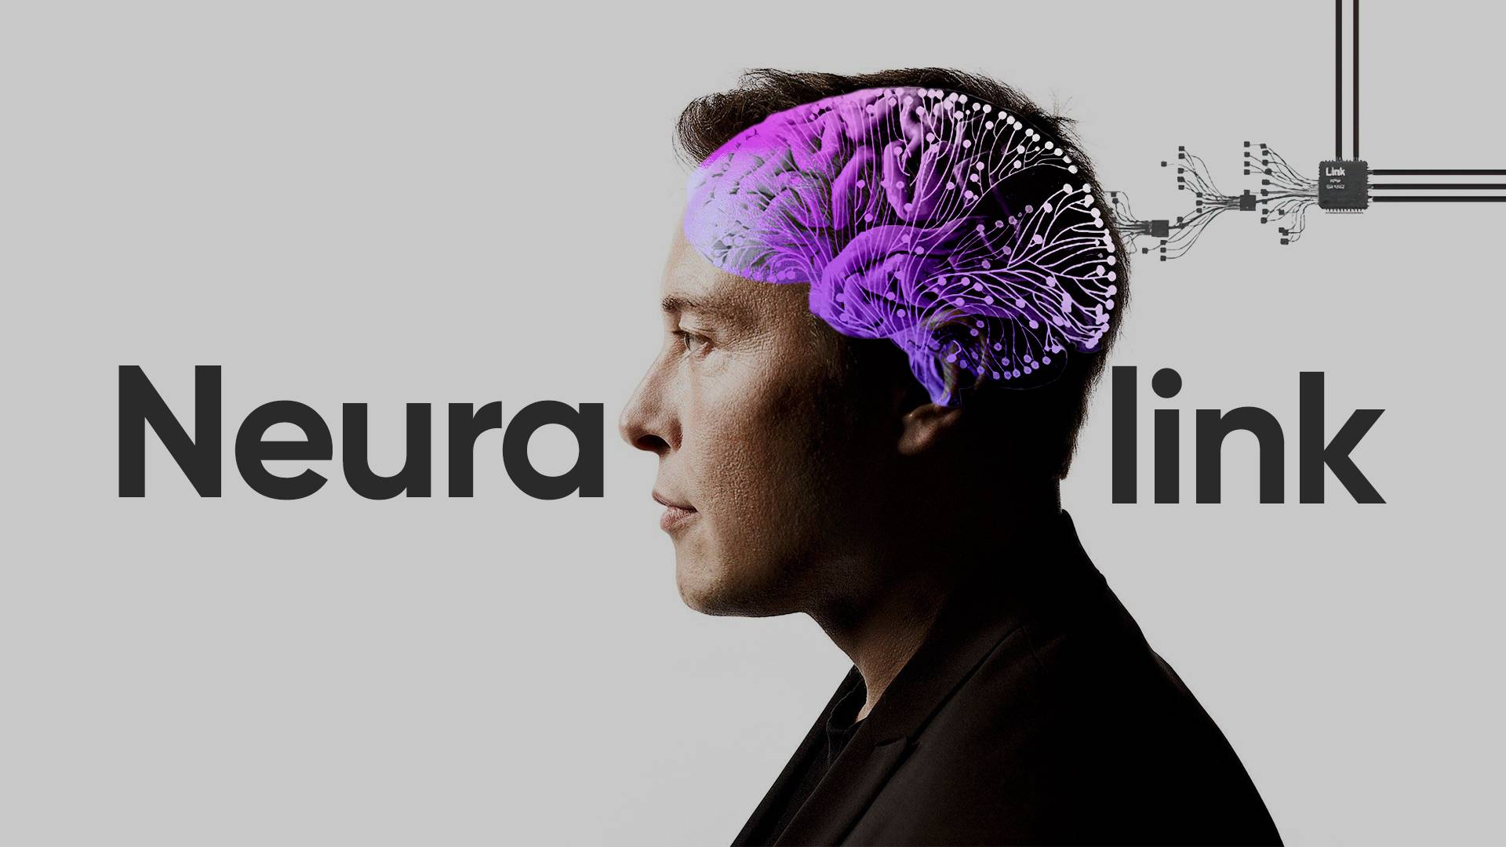
In 2016 he started Neuralink, a project that studies how to build brain – computer interfaces. That is to say, how to connect a human brain with a micro computer.

Slide 19
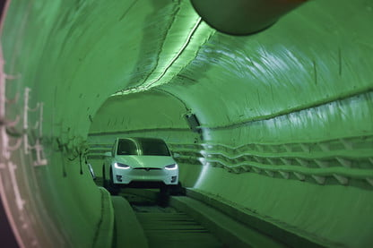
In 2016 he founded The Boring Company, a excavation and infrastructure company.

Slide 20
…

